Slide 1


Supervised and unsupervised learning with Johnson & Johnson Support Ticket
Ignacio Palma, Jairo Melo and Vikram Khade
York University
ML1000, Project presentation
22 March , 2019

Slide 2
Objective
Information Technology Service Management at Johnson and Johnson is always looking for opportunities to improve support services processes avoiding business impact reducing time and cost.
What’s the Problem?
Improve resolution time
2. Find alternatives to Shift-left work

Slide 3
Proposed Alternatives
What’s in the Data set?
A CSV file extracted from the ITSM system
21750 records
From 2018 to 2019
Features:
Application: Over 500 different applications
Application category: 15 categories
Product Line: 2 options (eg Cloud/Premise)
Open or creation Date
Resolution Date
Priority: 1, 2 or 3 (1 lowest - 3 Max)
Impact: 3 levels, (1 user – 3 all organization)
Region (13 regions) of user’s location
Support Group who’s providing the resolution (Over 200 support groups)
Group Level: 1 low expert – 3 High expert
Predict which Group Level will ended up resolving the issue so the lead of the support Team allocate the resources ahead.
Provide an estimation to the requester when the ticket might be resolved to manage uncertainty or use the time to look for alternatives
Find opportunities to Move support from the L3 level to L2 or L1.

Slide 4
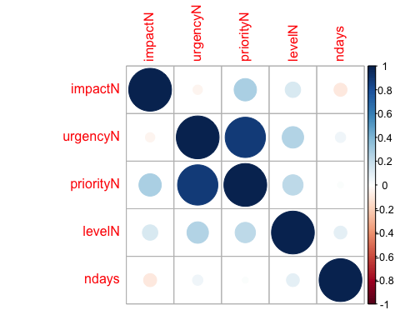
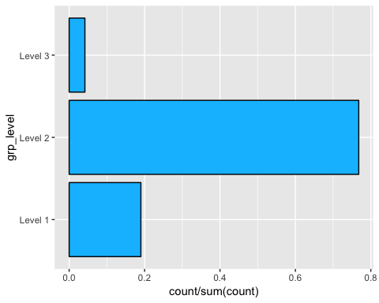
Supervised Learning – Group Level
What is the Problem?
The resolution of an issue is time sensitive, and the escalation process is causing not only unplanned resource allocation but business impact. Reliability team needs to identify the Group Level who will finally be involved in the resolution of the a ticket while the ticket is being created.
Predicting Group Level

Slide 5
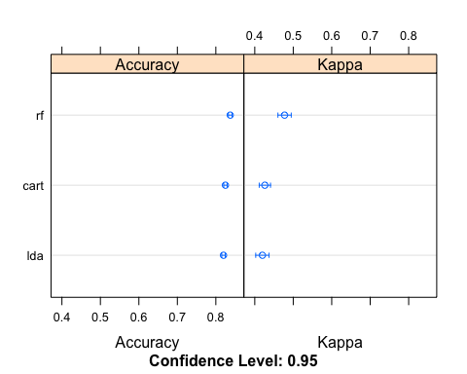
Supervised Learning – Group Level
Solution
Predicting the Group Level using Random Forest
 |  | Balanced Accuracy
Methods | Accuracy | Level 1 | Level 2 | Level 3
LDA | 0.82 | 0.70 | 0.67 | 0.50
CART | 0.82 | 0.70 | 0.67 | 0.50
RF | 0.83 | 0.73 | 0.70 | 0.50

Slide 6
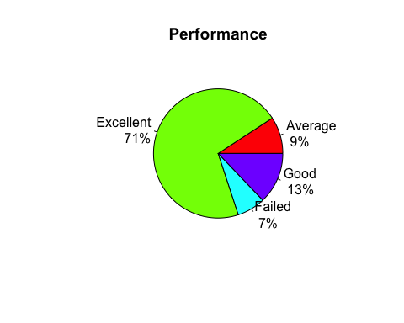
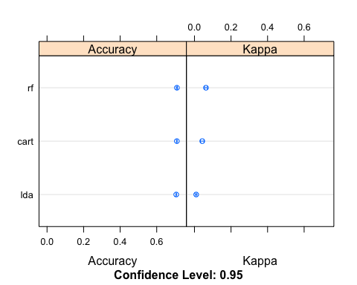
Supervised Learning - Performance
What is the Problem?
Users complain when the issue still outstanding without ETA, or the waiting time could have been used to escalate the issue or implement a workaround.
New Feature Performance = Resolved - Opened

Slide 7
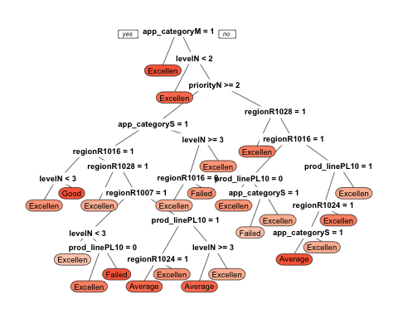
Supervised Learning - Performance
Solution
Predicting the performance of a new ticket using Classification and regression trees CART method
 |  | Balanced Accuracy
Methods | Accuracy | Excellent | Good | Average | Failed
LDA | 0.71 | 0.50 | 0.50 | 0.50 | 0.50
CART | 0.71 | 0.51 | 0.51 | 0.51 | 0.51
RF | 0.71 | 0.50 | 0.50 | 0.50 | 0.50

Slide 8
Conclusion - Supervised Learning
Random Forest works well to predict the Group Level
Classification and regression Trees (CART) method performed a slight better than the other methods, but with no optimal results.
Potential causes, under sampling, low predictability features
Room for further improvements:
Include additional features at the vendor level
Expanding the model to include other product lines
Bigger datasets.
We hope that our work will inspire further discussions at Johnson & Johnson regarding the evaluation of strategies such as predicting resolution. We believe that deeper understanding of those matters would allow the comparison of diﬀerent methods in a more systematic manner which would be beneﬁcial for the entire organization.

Slide 9
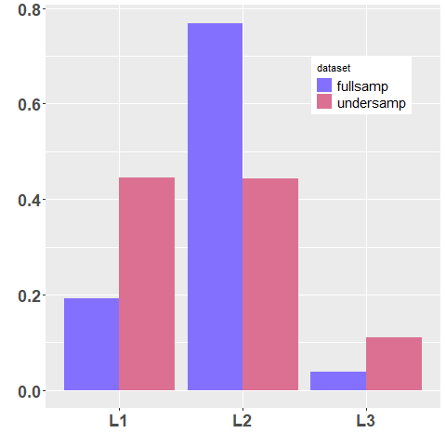
Clustering
Partitioning around Medoids (PAM)
We are looking for clusters dominated by L3 level. Such clusters are not found.
…. since the dataset is dominated by L2.
Solution : Majority under sampling Level 1
and Level 2.

Slide 10
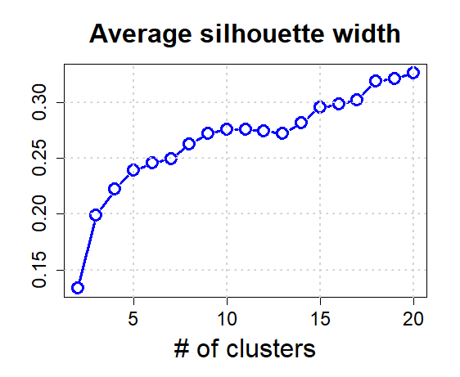
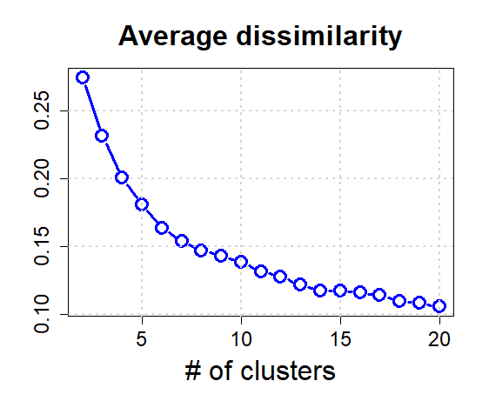

Slide 11
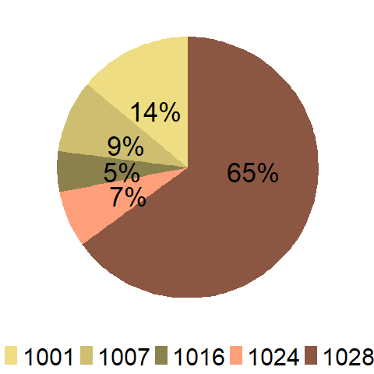
Region feature for a particular cluster
We have to inspect 20 x 8 piecharts !
A convenient visualization tool is the
heatmap.

Slide 12
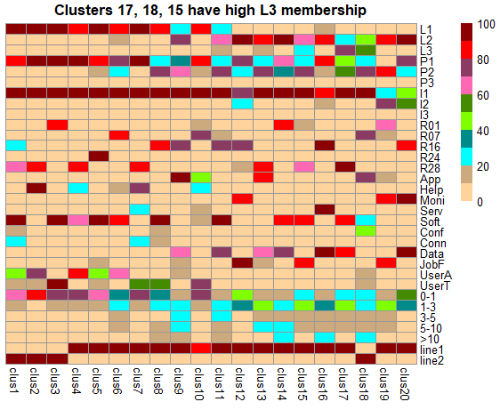
Level
Level
Priority
Impact
Region
App_category
Res_category
Res_category
ndays
ndays
Prod Line
Prod Line

Slide 13
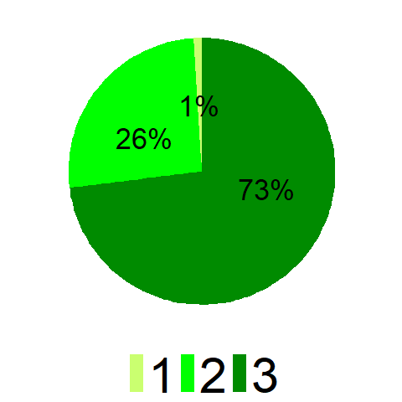
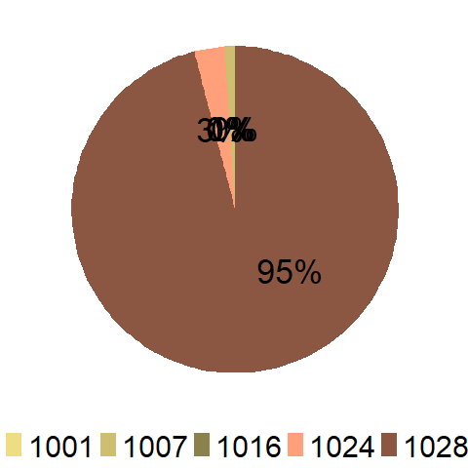
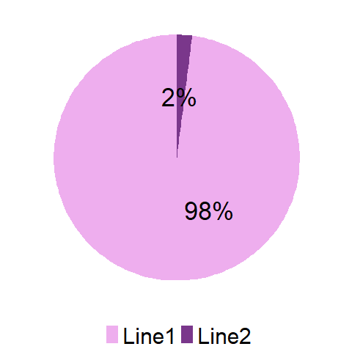
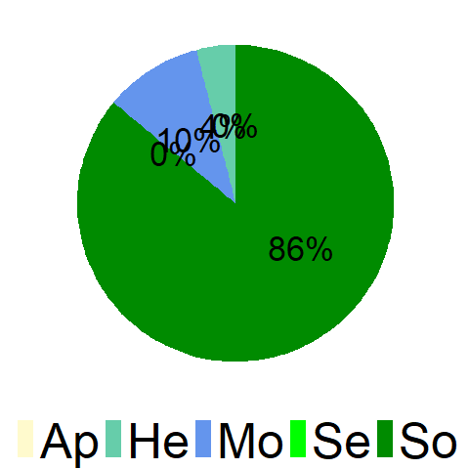
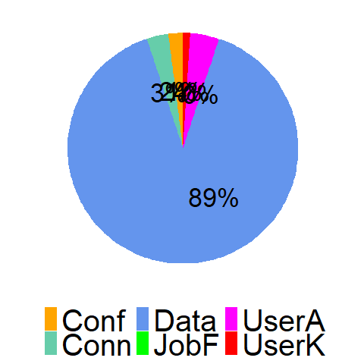
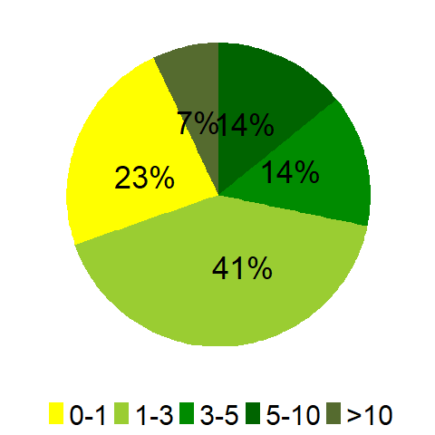
C
L
U
S
T
E
R
17

Slide 14
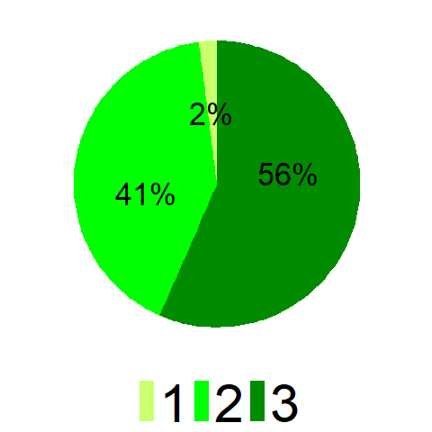
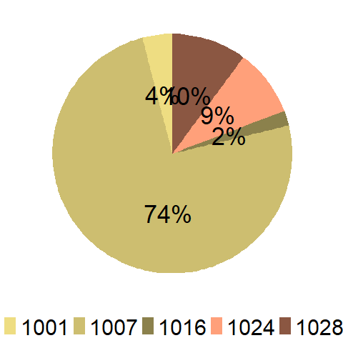
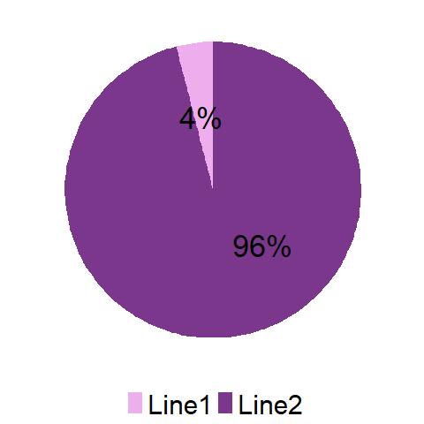
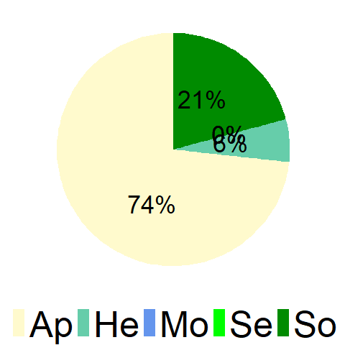
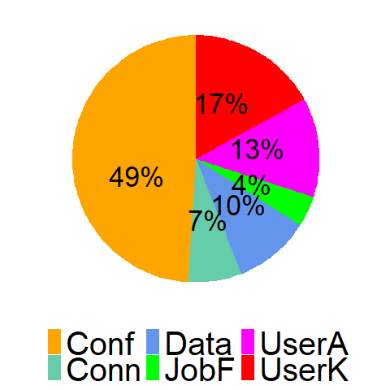
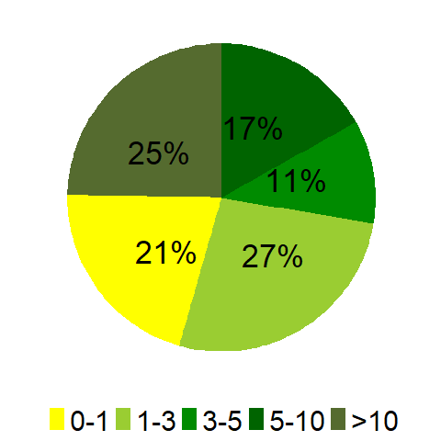
C
L
U
S
T
E
R
18

Slide 15
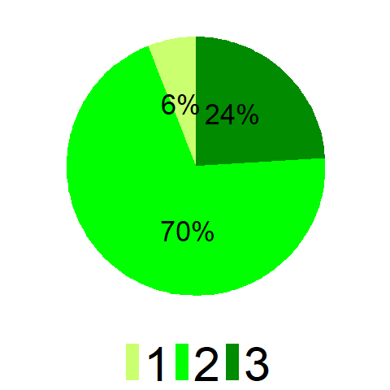
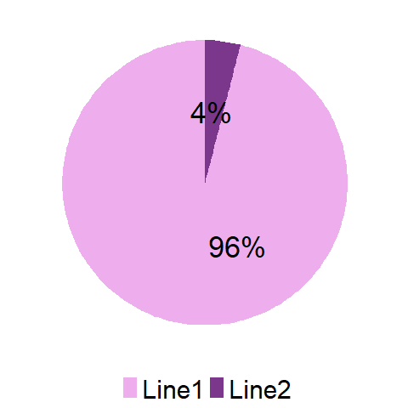
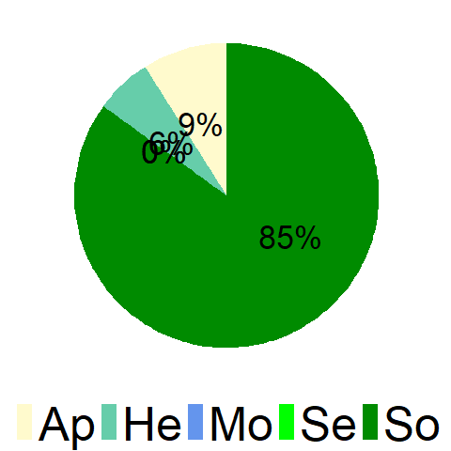
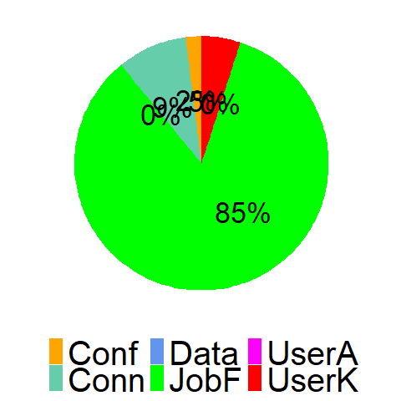
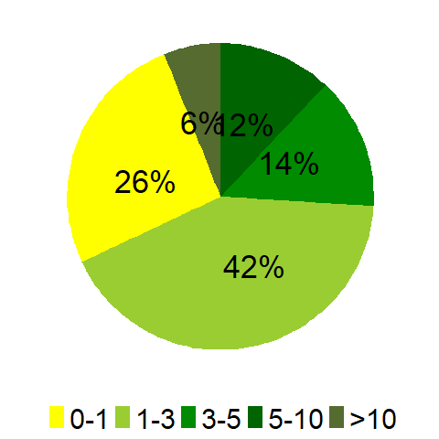
C
L
U
S
T
E
R
15

Slide 16
Recommendation
Cluster # | Level | Priority | Impact | App_category | Res_category | Region | Prod_line | ndays
# 17 | L3 | P1 & P2 | I1 | Software | Data Issues | 1028 | Line 1 | Mixed
# 18 | L2 & L3 | P2 | I1 | Application | Configuration | 1007 | Line 2 | Mixed
# 15 | L2 | P2 | I1 | Software | Job failure | 1028 | Line 1 | Mixed
J&J should look into the above segments for cost cutting by
devising strategies to push L2 & L3 tickets to L1.

